Slide 1


Generative Artificial Intelligence

Slide 2


Agenda
Definition and importance of generative AI
Types of generative AI
Applications and examples
Ethical considerations
Future prospects
Discussion

Slide 3
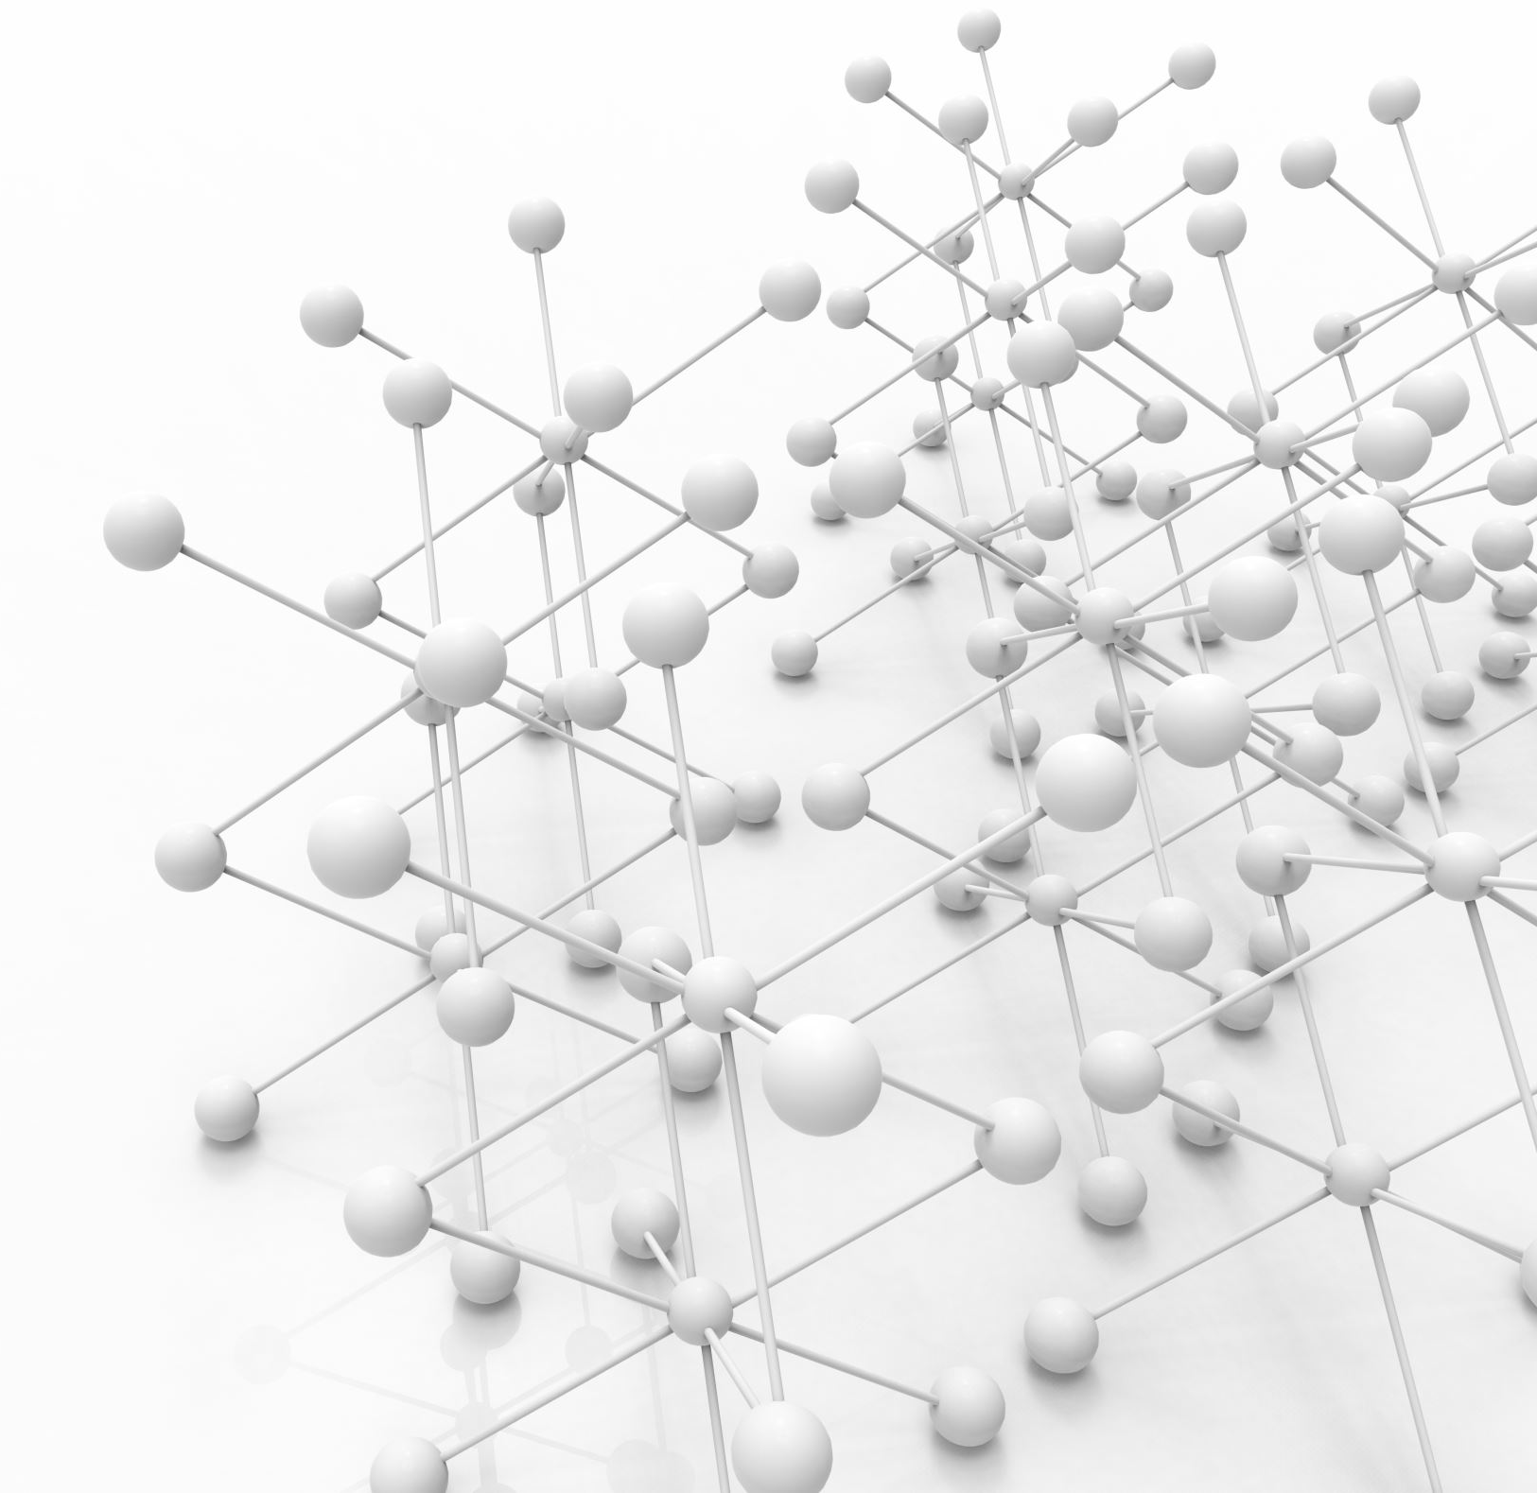
What is Generative AI?
Definition: Generative Artificial Intelligence refers to algorithms and models designed to create new content that resembles the data they were trained on
Importance: Generative AI plays a pivotal role in various domains by fostering creativity, aiding in content generation, and offering novel solutions to complex problems

Slide 4
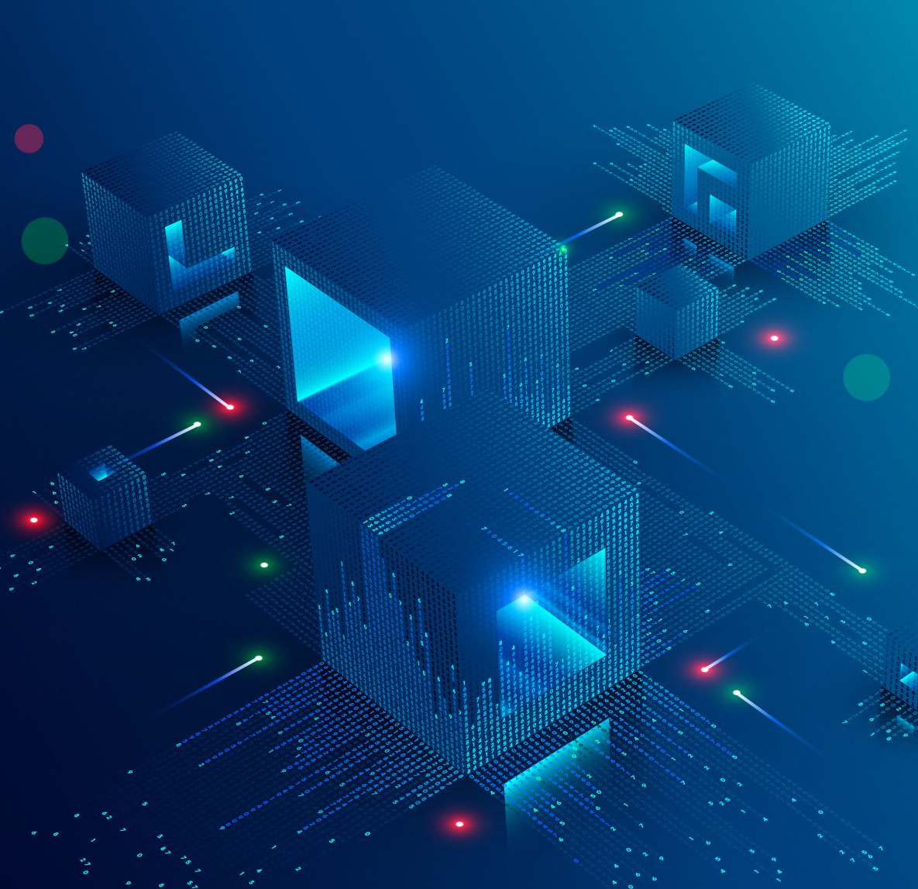
Types of Generative AI
Generative Adversarial Networks (GANs)
Architecture: GANs consist of two neural networks: a generator and a discriminator
Example: GANs are widely used for tasks such as image generation, style transfer, data augmentation, and anomaly detection
Variational Autoencoders (VAE)
Structure: VAEs comprise an encoder network that compresses input data into a latent space representation and a decoder network that reconstructs the original data from the latent space
Applications: VAEs are utilized for tasks like image generation, anomaly detection, data imputation, and dimensionality reduction
Recurrent Neural Networks (RNN)
Description: RNNs are a class of neural networks designed to process sequential data by maintaining a memory state
Examples: RNNs find applications in text generation, music composition, video captioning, and speech synthesis.

Slide 5
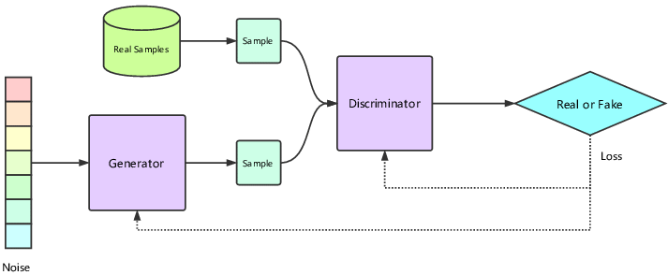
Generative Adversarial Networks (GANs)
Generator: The generator's role is to create synthetic data, such as images, from random noise or a latent space representation. It learns to generate data that is indistinguishable from real data by continuously improving its ability to produce realistic samples.
Discriminator: The discriminator is tasked with distinguishing between real data samples and those generated by the generator. It learns to differentiate between the two types of data and provides feedback to the generator on how to improve the realism of its generated samples.

Slide 6

Variational Autoencoders (VAE)

Slide 7
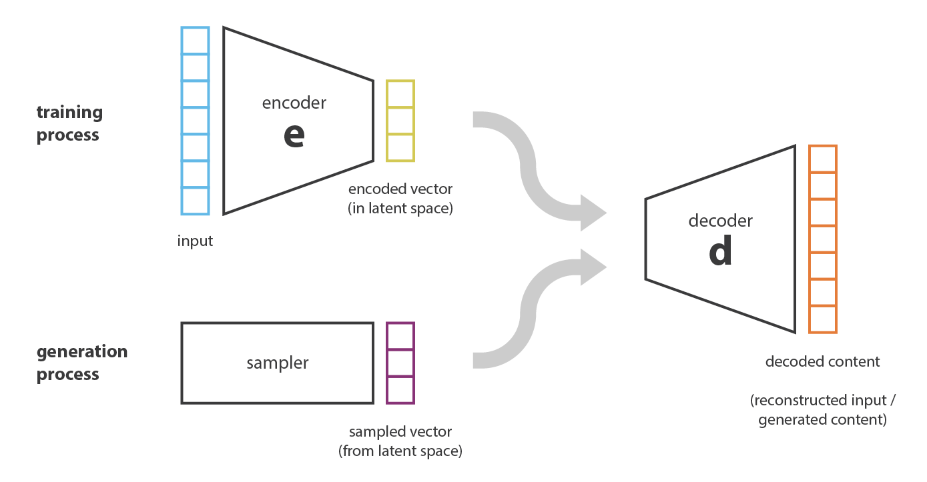
Variational Autoencoders (VAE)
Encoder: The encoder network takes an input data point and maps it to a latent space representation, typically a lower-dimensional space. The encoder compresses the input data into a probability distribution over the latent space, allowing for the capture of essential features of the input.
Decoder: The decoder network takes a point from the latent space and reconstructs the input data from it. It learns to decode the latent space representation back into the original data space, effectively generating synthetic data samples.

Slide 8
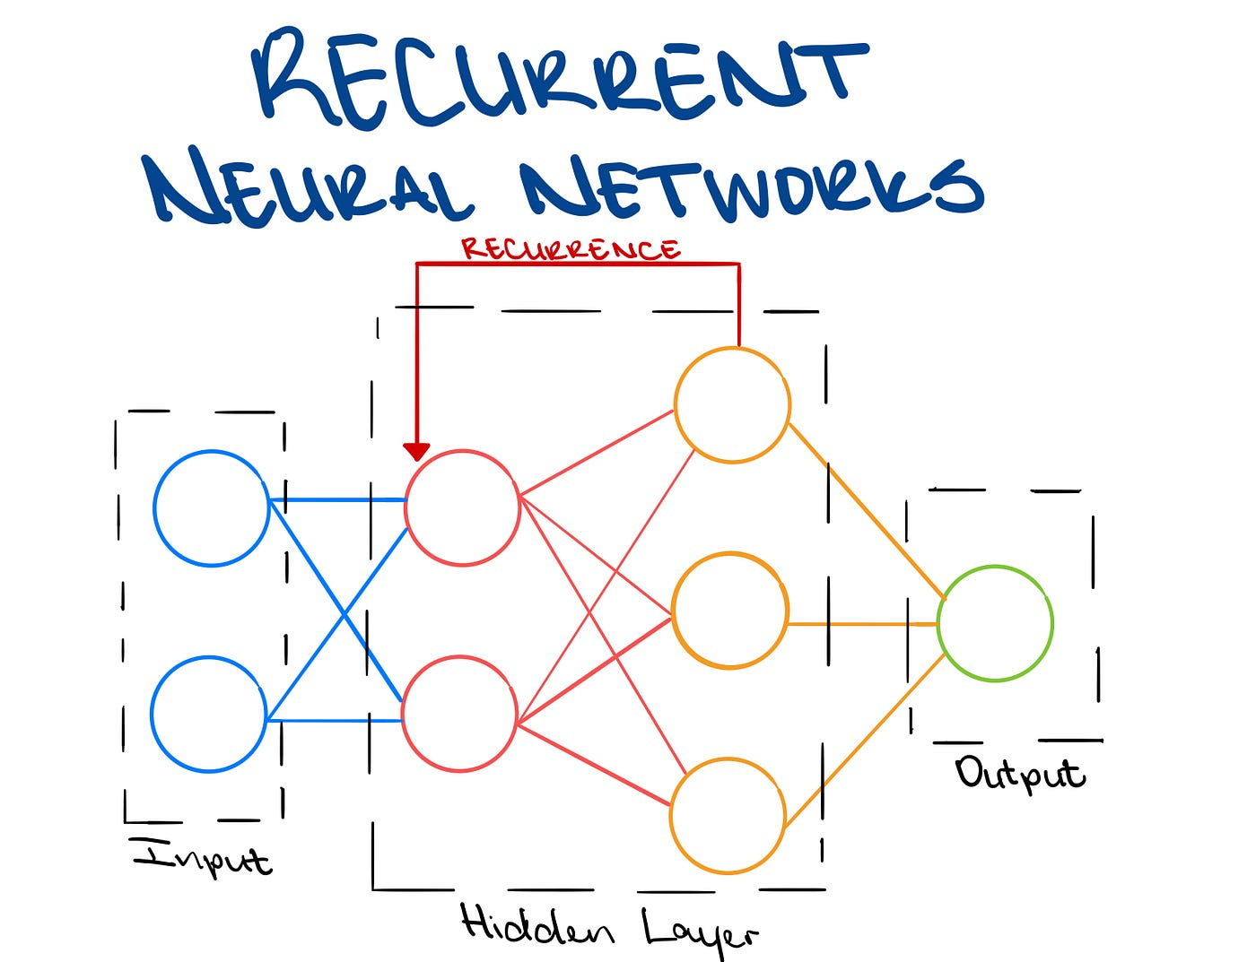
Recurrent Neural Networks (RNN)
Recurrent Neural Networks (RNNs) are a type of neural network architecture commonly used in generative AI tasks for processing sequential data. Unlike traditional feedforward neural networks, which process data in a single pass, RNNs have connections that form directed cycles, allowing them to maintain internal state or memory.
In the context of generative AI, RNNs excel at tasks that involve sequential data generation, such as text generation, music composition, video captioning, and speech synthesis.

Slide 9
Applications of Generative AI
Generative AI facilitates the creation of original artwork, music compositions, and literary texts
In marketing and entertainment industries, generative AI is utilized to generate images, videos, and text for advertisements, social media content, and storytelling
Generative AI plays a crucial role in healthcare by generating synthetic medical images for training diagnostic models, drug discovery, and molecule design
Game developers leverage generative AI for procedural content generation, including the creation of game levels, characters, and narratives

Slide 10



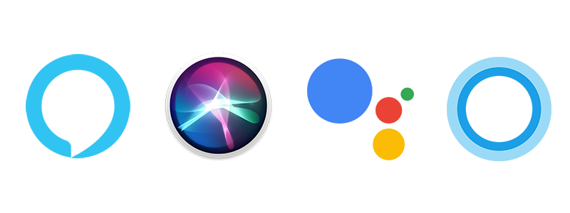

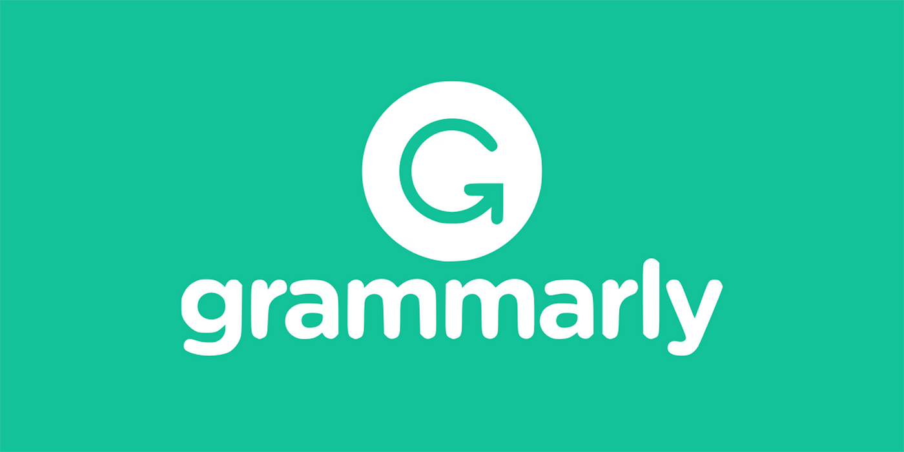
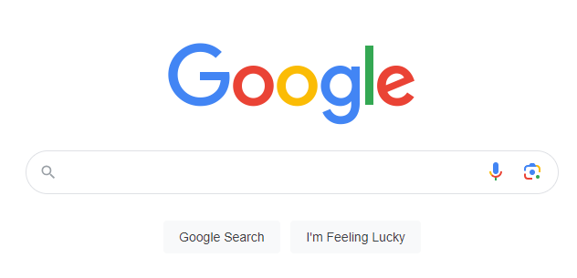


Applications of Generative AI
GANs
VAEs
RNN
Content-aware fill
Auto-Enhance
Content Recommendation

Slide 11

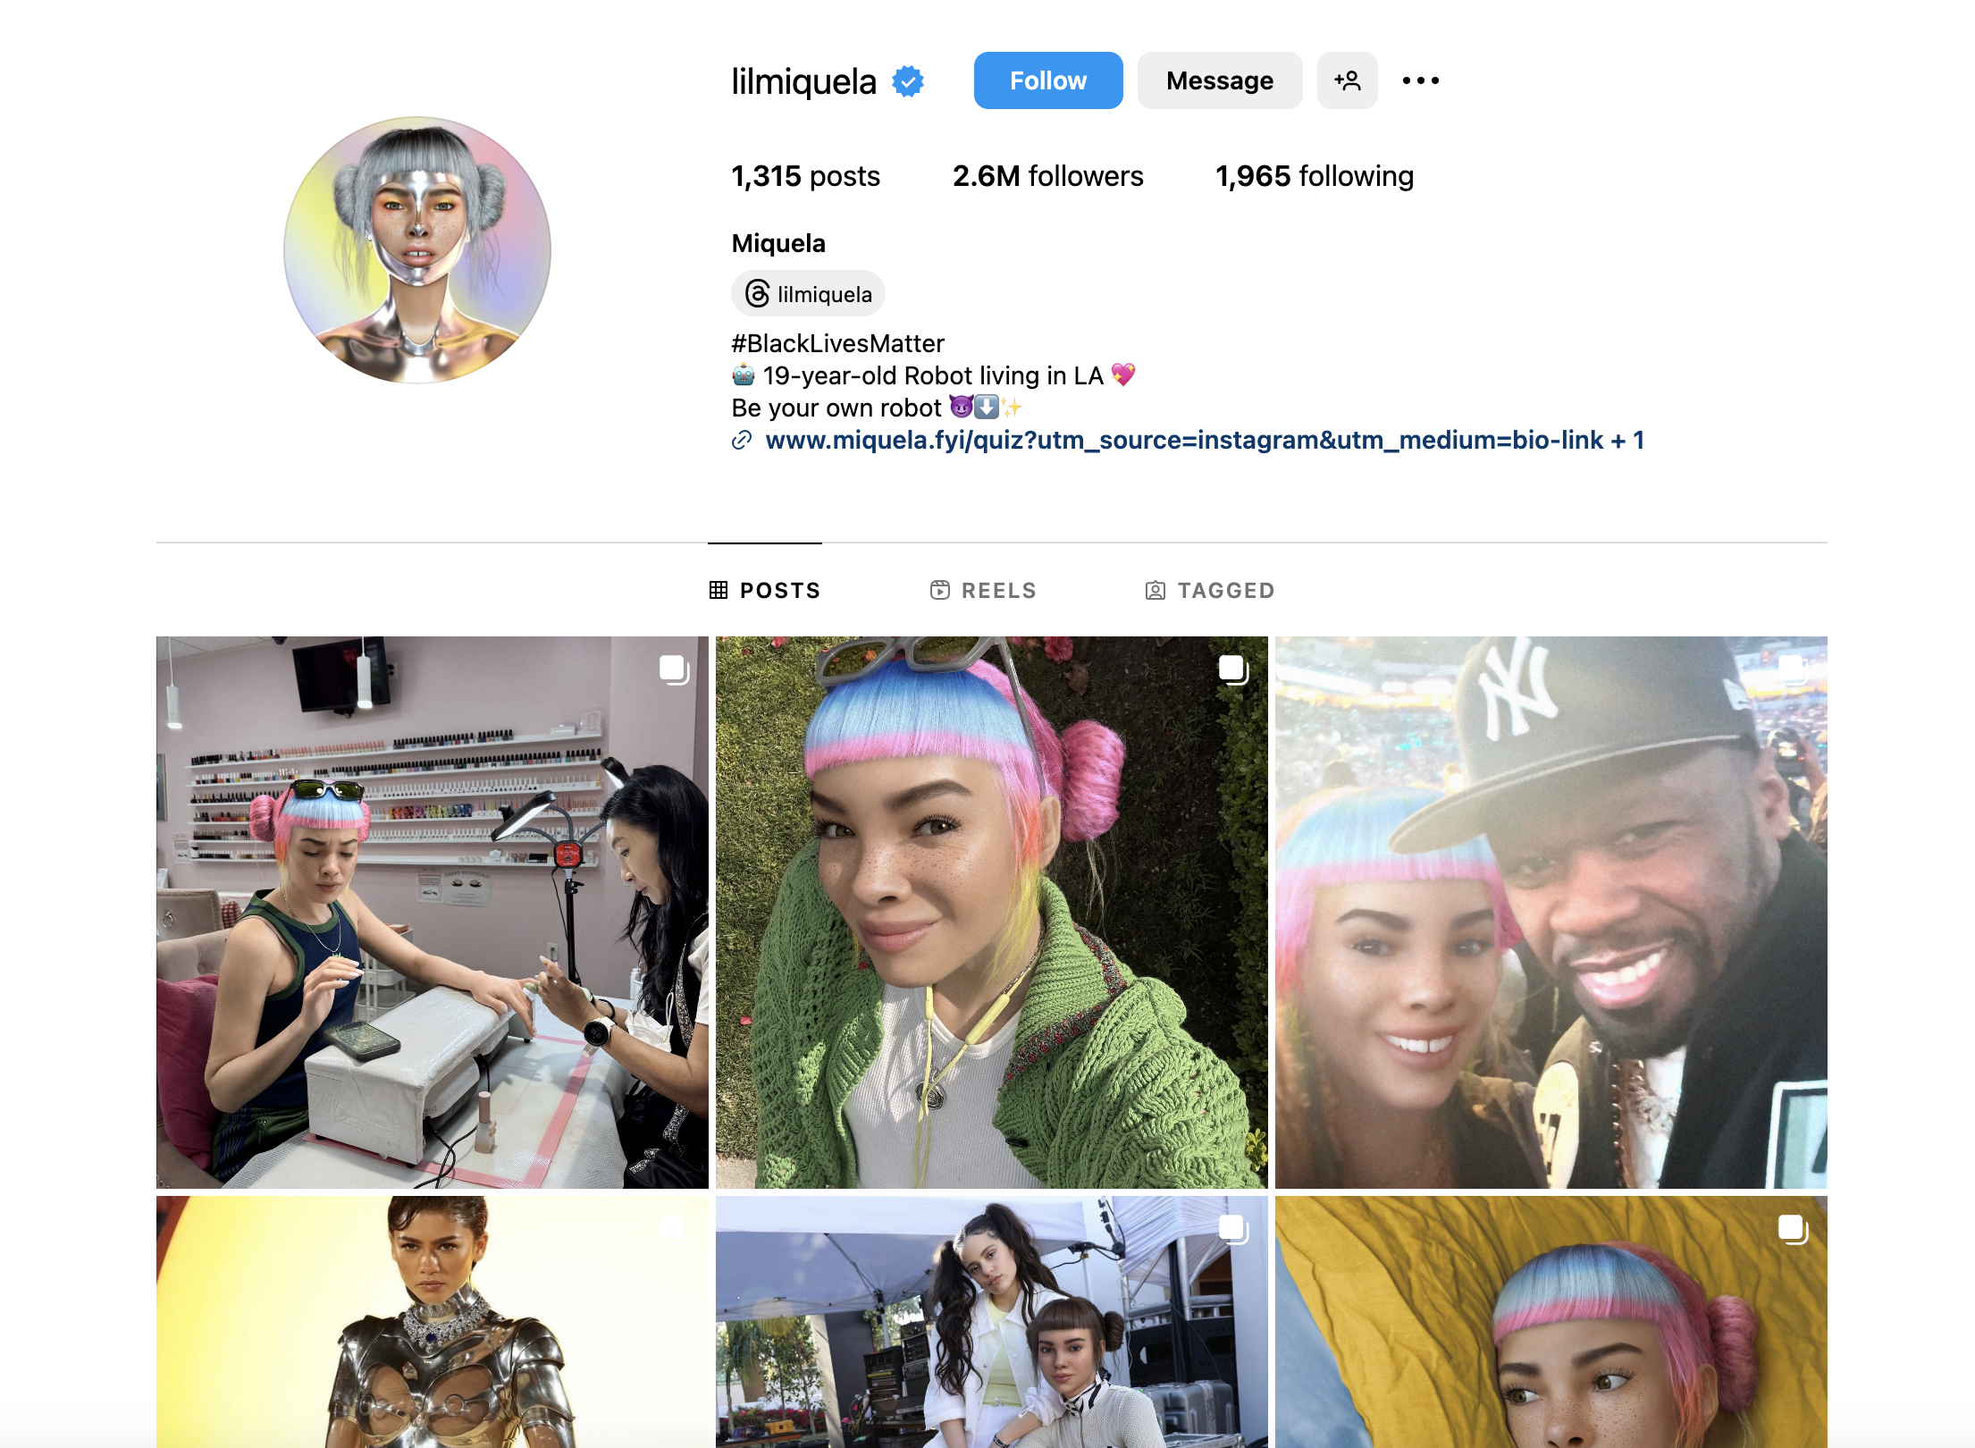
Virtual influencers

Slide 12


AI generated music

Slide 13
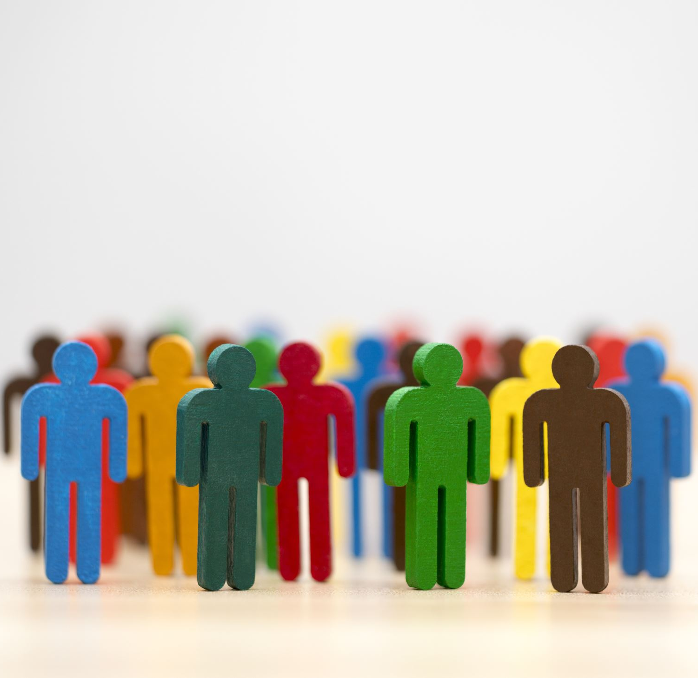
Ethical Considerations
Bias and Fairness: Generative AI models can perpetuate biases present in the training data, leading to unfair outcomes or discrimination against certain groups
Misinformation and Manipulation: There is a risk of generating misleading or false content, which could be exploited for misinformation campaigns or malicious purposes
Privacy Concerns: Generating synthetic faces, voices, or personal data raises concerns about privacy infringement and consent, particularly in contexts like deepfakes or identity theft
Job Displacement: The widespread adoption of generative AI in content creation industries may lead to job displacement for professionals such as artists, writers, and designers, raising questions about workforce implications and retraining needs.

Slide 14

Future Prospects
Advancements in Creativity: Continued research and development in generative AI are expected to enhance its ability to produce high-quality, diverse, and contextually relevant content across various domains
Integration with Other Technologies: Generative AI will likely be integrated with emerging technologies such as robotics, augmented reality , and virtual reality to create immersive and interactive experiences
Ethical and Regulatory Frameworks: As generative AI becomes more prevalent, there is a growing need for ethical guidelines and regulatory frameworks to ensure responsible development, deployment, and use of these technologies
New Frontiers: The future of generative AI holds promise in areas like education, urban planning, and scientific research, where it can offer innovative solutions to complex problems and foster human-AI collaboration.

Slide 15
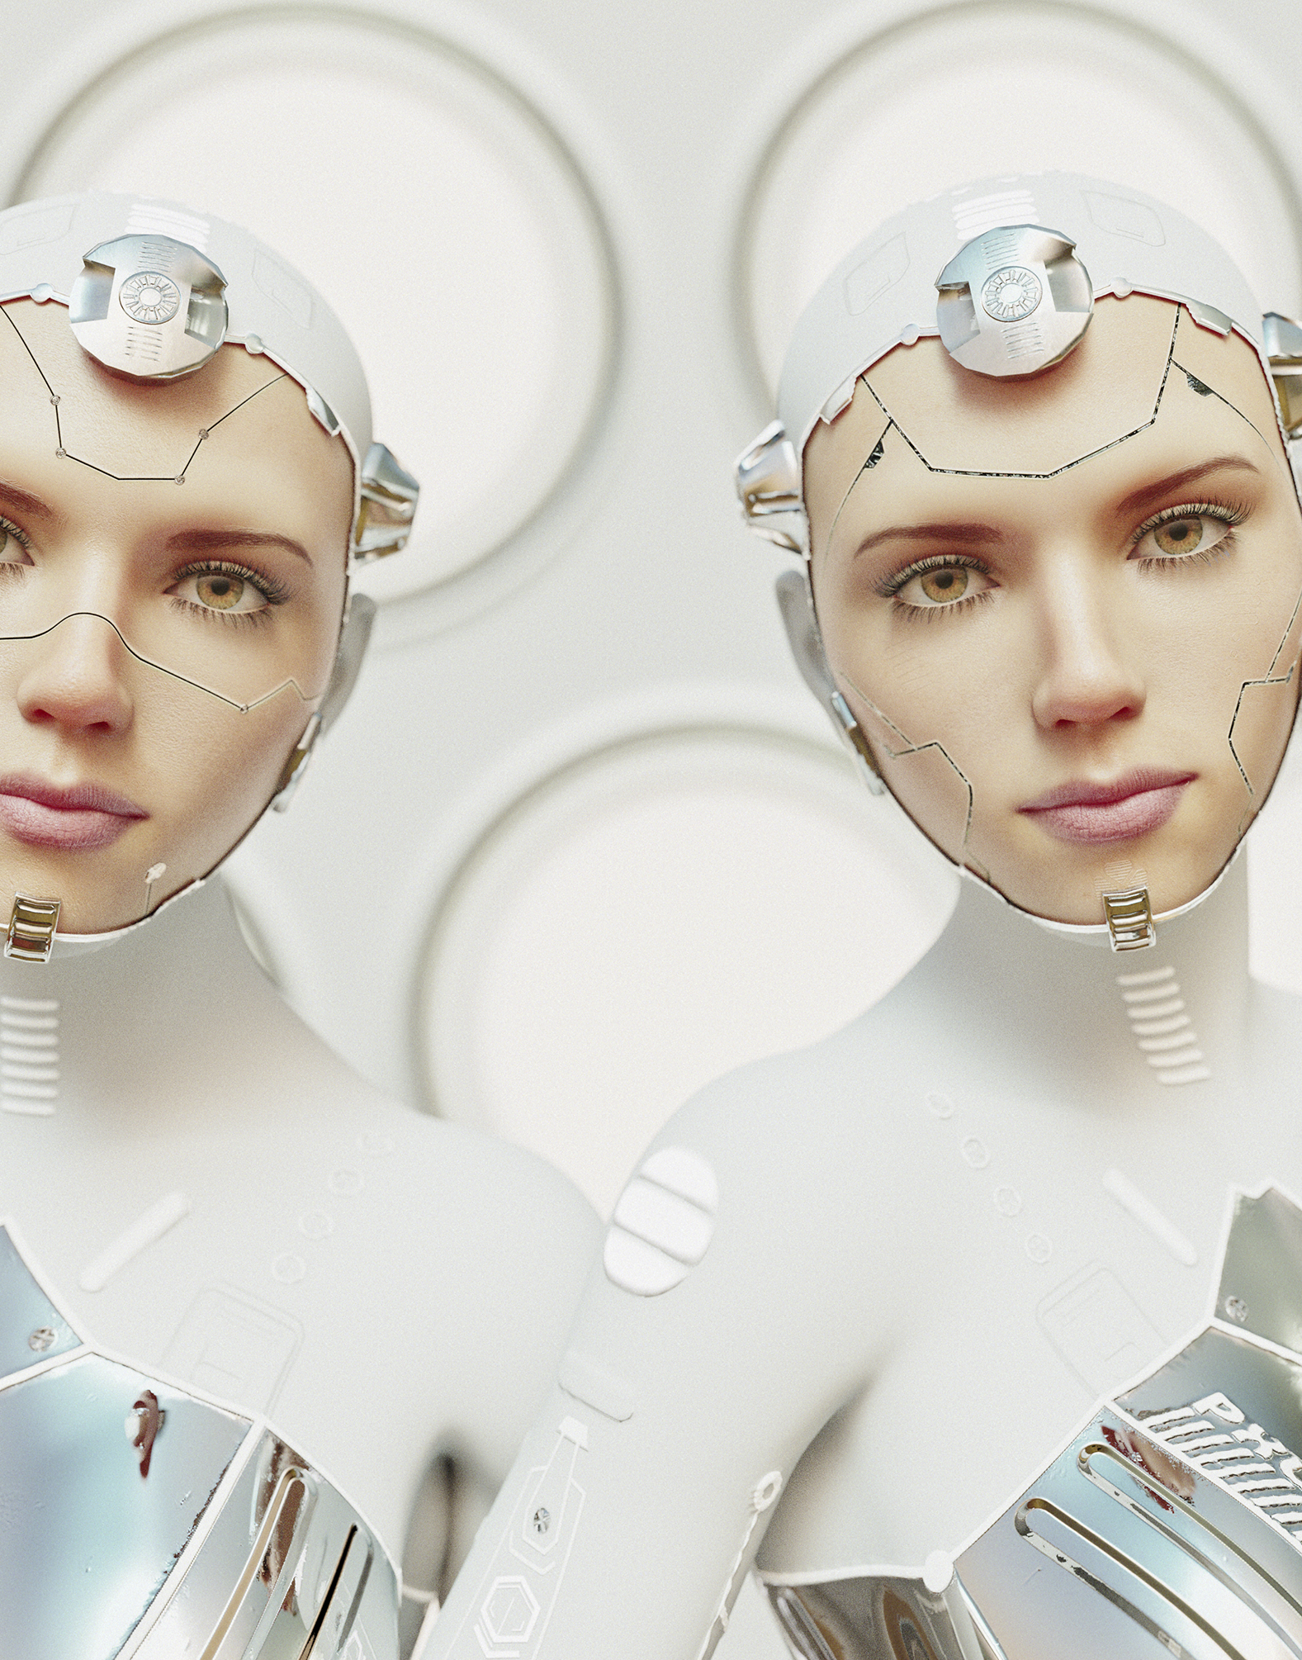
Discussion:
Will people become redundant due to Generative AI?
Is “creativity” something that can be copied?
How will the future be like in 10, 50 and 100 years?

Slide 16
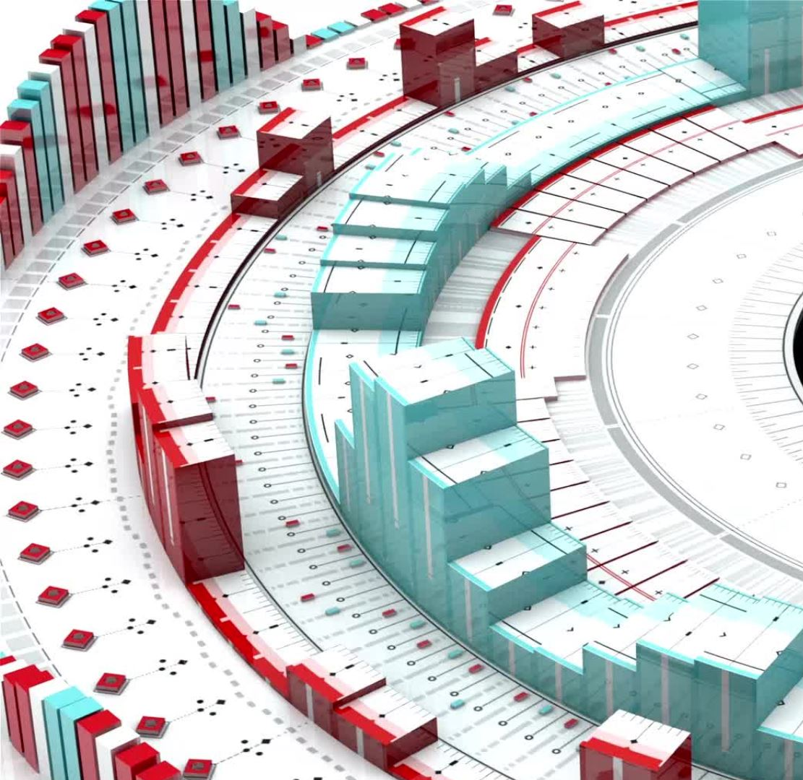
Conclusion
Recap:
Generative AI is a powerful tool that enables the creation of new content across diverse domains, driven by models like GANs, VAEs, and RNNs
Thank you for attending the lecture and exploring the fascinating world of generative AI!

